Slide 1
Unit: 8 JAVAFX UI Controls and Multimedia
Prof. Ravikumar R Natarajan
Dept. of CE

Slide 2
Contents
Labeled and Label
Button
Checkbox
RadioButton
Textfield
TextArea
Combo Box
ListView
Scrollbar
Slider
Video and Audio

Slide 3
Introduction
JavaFX provides many UI controls for developing a comprehensive user interface.
A graphical user interface (GUI) makes a system user-friendly and easy to use. Creating a GUI requires creativity and knowledge of how UI controls work.
Since the UI controls in JavaFX are very flexible and versatile, you can create a wide assortment of useful user interfaces for rich Internet applications.

Slide 4
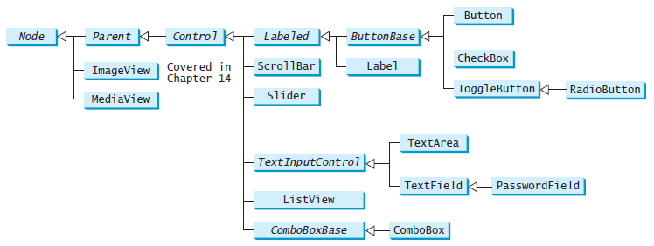
UI Controls
These UI controls are frequently used to create user interfaces.

Slide 5
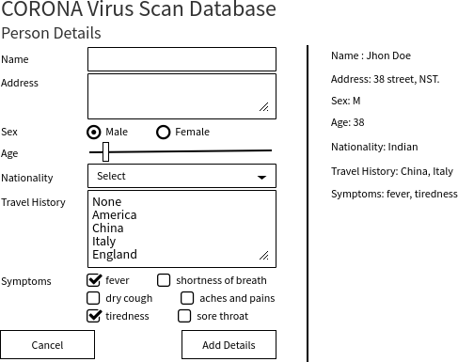
A Sample UI Form

Slide 6
Labeled and Label
A label is a display area for a short text, a node, or both.
It is often used to label other controls (usually text fields).
Labels and buttons share many common properties.
These common properties are defined in the Labeled class.
Labeled nodes can have the graphic property also, which can be any node such as a shape, an image, or a control.

Slide 7
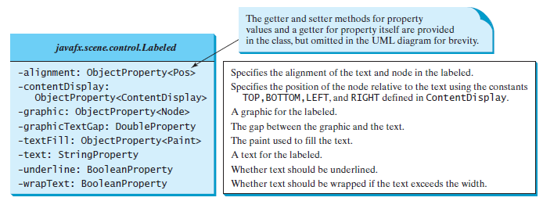
Labeled and Label
Label is created to display a text or a node, or both.
*For Example Refer Unit 8 Demo Programs Folder

Slide 8
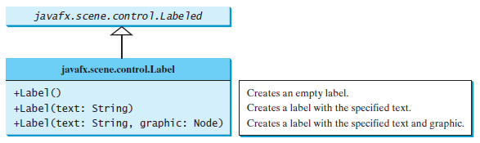
Labeled and Label
Labeled defines common properties for Label, Button, CheckBox, and RadioButton

Slide 9
Labeled and Label
import javafx.application.Application;
import javafx.scene.Scene;
import javafx.scene.control.*; import javafx.scene.layout.*;
import javafx.event.ActionEvent; import javafx.event.EventHandler;
import javafx.scene.control.Label; import javafx.stage.Stage;
public class labelDemo extends Application {
public void start(Stage s) {
s.setTitle("Calculator");
Label b = new Label("This is a Label");
Pane r = new Pane();
r.getChildren().addAll(b);
Scene sc = new Scene(r, 600, 600);
s.setScene(sc);
s.show();
}
public static void main(String args[]) {
launch(args); } }

Slide 10
ButtonBase and Button
A button is a control that triggers an action event when clicked.
JavaFX provides regular buttons, toggle buttons, check box buttons, and radio buttons.
The common features of these buttons are defined in ButtonBase and Labeled classes.
The Labeled class defines the common properties for labels and buttons.
A button is just like a label except that the button has the onAction property defined in the ButtonBase class, which sets a handler for handling a button’s action.

Slide 11
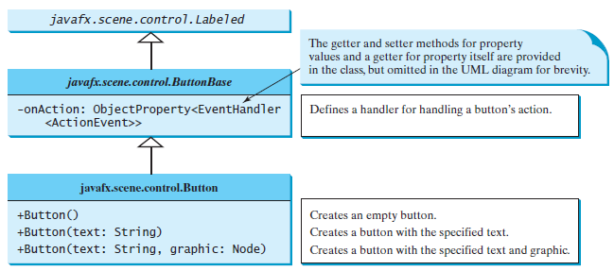
Button
*For Example Refer Unit 8 Demo Programs Folder

Slide 12
CheckBox
A CheckBox is used for the user to make a selection.
Like Button, CheckBox inherits all the properties such as onAction, text, graphic, alignment, graphicTextGap, textFill, contentDisplay from ButtonBase and Labeled.
Additionally, it provides the selection property to indicate whether a check box is selected.
When a check box is clicked (checked or unchecked), it fires an ActionEvent.
To see if a check box is selected, use the isSelected() method.

Slide 13
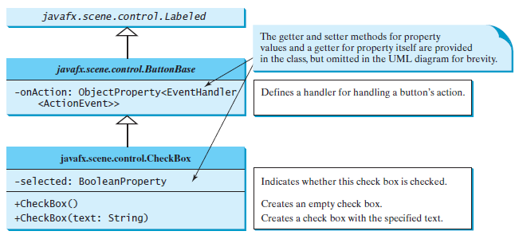
CheckBox
*For Example Refer Unit 8 Demo Programs Folder

Slide 14
Radio Button
Radio buttons, also known as option buttons, enable the user to choose a single item from a group of choices.
In appearance radio buttons resemble check boxes, but check boxes display a square that is either checked or blank, whereas radio buttons display a circle that is either filled (if selected) or blank (if not selected).
RadioButton is a subclass of ToggleButton.
The difference between a radio button and a toggle button is that a radio button displays a circle, but a toggle button is rendered similar to a button.

Slide 15
Radio Button
To group radio buttons, you need to create an instance of ToggleGroup and set a radio button’s toggleGroup property to join the group.
When a radio button is changed (selected or deselected), it fires an ActionEvent . To see if a radio button is selected, use the isSelected() method.

Slide 16
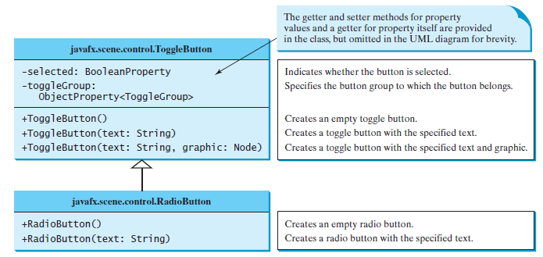
RadioButton
*For Example Refer Unit 8 Demo Programs Folder

Slide 17
RadioButton, CheckBox, Button, Vbox, Hbox

Slide 18
TextField
A text field can be used to enter or display a string.
TextField is a subclass of TextInputControl.
When you move the cursor in the text field and press the Enter key, it fires an ActionEvent.

Slide 19
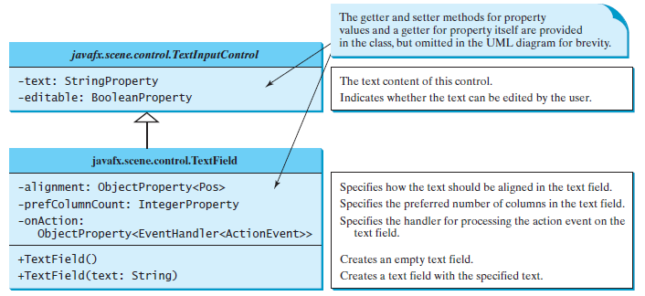
TextField
*For Example Refer Unit 8 Demo Programs Folder

Slide 20
Identify TextField

Slide 21
TextArea
A TextArea enables the user to enter multiple lines of text.
If you want to let the user enter multiple lines of text, you may create several instances of TextField.
A better alternative, however, is to use TextArea, which enables the user to enter multiple lines of text.
TextArea also provides scrolling, but often it is useful to create a ScrollPane object to hold an instance of TextArea and let ScrollPane handle scrolling for TextArea.

Slide 22
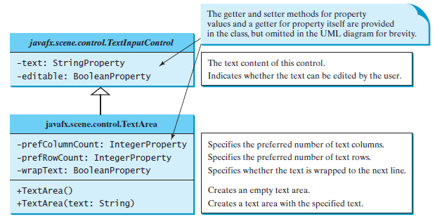
TextArea
*For Example Refer Unit 8 Demo Programs Folder

Slide 23
ComboBox
A combo box, also known as a choice list or drop-down list, contains a list of items from which the user can choose.
A combo box is useful for limiting a user’s range of choices and avoids the cumbersome validation of data input.
ComboBox inherits from ComboBoxBase.
ComboBox is defined as a generic class.
The generic type T specifies the element type for the elements stored in a combo box.
ComboBox<String> cbo = new ComboBox<>();
cbo.getItems().addAll("Item 1", "Item 2", "Item 3", "Item 4");
cbo.setStyle("-fx-color: red");
cbo.setValue("Item 1");

Slide 24
ComboBox
ComboBox can fire an ActionEvent.
Whenever an item is selected, an ActionEvent is fired.
ObservableList is a subinterface of java.util.List. So you can apply all the methods defined in List for an ObservableList.
For convenience, JavaFX provides the static method FXCollections.observableArrayList(arrayOfElements) for creating an ObservableList from an array of elements.

Slide 25
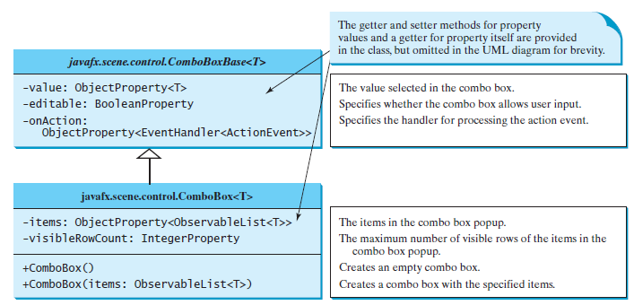
ComboBox
*For Example Refer Unit 8 Demo Programs Folder

Slide 26
ListView
A list view is a control that basically performs the same function as a combo box, but it enables the user to choose a single value or multiple values.
ListView is defined as a generic class.
The generic type T specifies the element type for the elements stored in a list view.
The getSelectionModel() method returns an instance of SelectionModel, which contains the methods for setting a selection mode and obtaining selected indices and items.
The selection mode is defined in one of the two constants SelectionMode.MULTIPLE and
SelectionMode.SINGLE, which indicates whether a single item or multiple items can be selected.
The default value is SelectionMode.SINGLE.

Slide 27
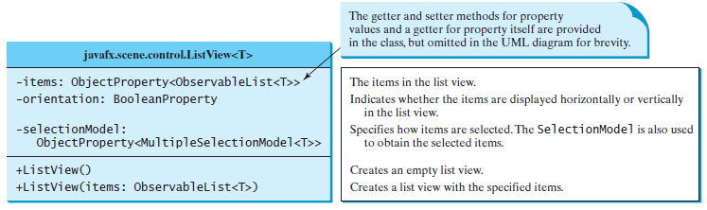
ListView
*For Example Refer Unit 8 Demo Programs Folder

Slide 28
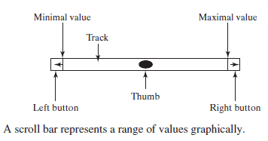
ScrollBar
ScrollBar is a control that enables the user to select from a range of values.
Normally, the user changes the value of a scroll bar by making a gesture with the mouse.
For example, the user can drag the scroll bar’s thumb, click on the scroll bar track, or the scroll bar’s left or right buttons.
When the user changes the value of the scroll bar, it notifies the listener of the change.
You can register a listener on the scroll bar’s valueProperty for responding to this change.

Slide 29
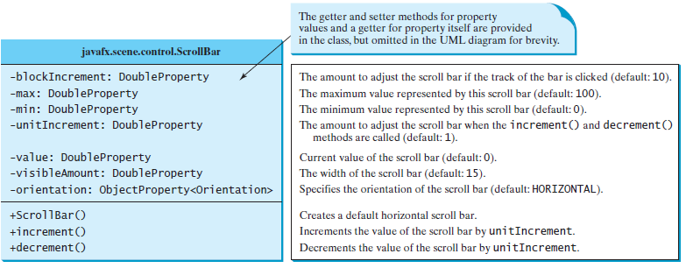
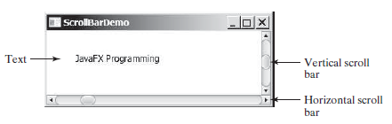
ScrollBar
*For Example Refer Unit 8 Demo Programs Folder

Slide 30
Slider
Slider is similar to ScrollBar, but Slider has more properties and can appear in many forms.
Slider lets the user graphically select a value by sliding a knob within a bounded interval.
The slider can show both major tick marks and minor tick marks between them.
The number of pixels between the tick marks is specified by the majorTickUnit and minorTickUnit properties.
Sliders can be displayed horizontally or vertically, with or without ticks, and with or without labels.
You can add a listener to listen for the value property change in a slider in the same way as in a scroll bar.

Slide 31
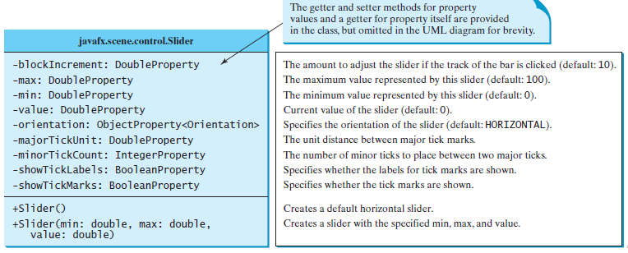
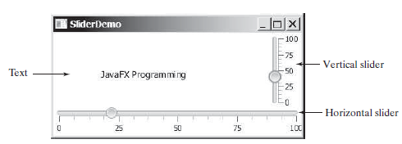
Slider
*For Example Refer Unit 8 Demo Programs Folder

Slide 32
Video and Audio
You can use the Media class to obtain the source of the media, the MediaPlayer class to play and control the media, and the MediaView class to display the video.
Media (video and audio) is essential in developing rich Internet applications.
Currently, JavaFX supports MP3, AIFF, WAV, and MPEG-4 audio formats and FLV and MPEG-4 video formats.

Slide 33
Video and Audio
The Media class represents a media source with properties duration, width, and height.
You can construct a Media object from an Internet URL string.
A Media object supports live streaming.
A Media object can be shared by multiple media players and different views can use the same MediaPlayer object.

Slide 34
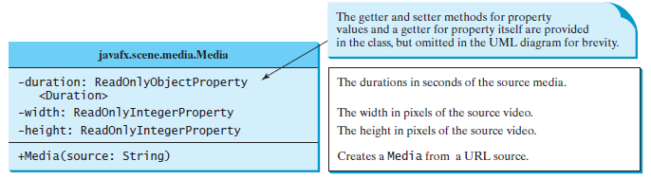
Media Class
*For Example Refer Unit 8 Demo Programs Folder

Slide 35
MediaPlayer class
The MediaPlayer class plays and controls the media with properties such as autoPlay, currentCount, cycleCount, mute, volume, and totalDuration.
You can construct a MediaPlayer object from a media and use the pause() and play() method to pause and resume playing.

Slide 36
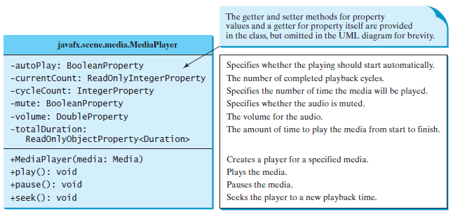
MediaPlayer Class
*For Example Refer Unit 8 Demo Programs Folder

Slide 37
MediaView class
The MediaView class is a subclass of Node that provides a view of the Media being played by a MediaPlayer.
The MediaView class provides the properties for viewing the media.

Slide 38
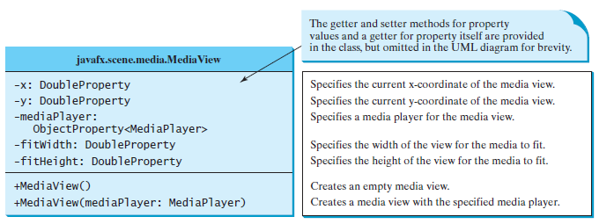
MediaView class
*For Example Refer Unit 8 Demo Programs Folder

Slide 39
Summary
Labeled and Label
Button
Checkbox
RadioButton
Textfield
TextArea
Combo Box
ListView
Scrollbar
Slider
Video and Audio

Slide 40
Queries??
Thank You

